Slide 1
Network Models -
OSI, TCP/IP
OSI LAYERS

Slide 2
OSI Model
OSI means Open System Interconnect model.
Developed by the International Organization for Standardization in 1974.
It consists of seven layers.
Each layer has a different but specific processing function.

Slide 3
OSI Model Layers
Layer - 7
Application
Advice
Upper Layer
or
Software Layer
Layer - 6
Presentation
Person
Layer - 5
Session
Sales
Transport
Take
Layer - 4
Heart of OSI
Layer - 3
Network
Not
Lower Layer
or
Hardware Layer
Layer - 2
Data Link
Do
Layer - 1
Physical
Please

Slide 4
Application Layer
Application
Application Layer is responsible for providing Networking Services to user. It also known as Desktop Layer. Identification of Services is done using Port Numbers.
Ports are nothing but Socket i.e. Entry and Exit Point to the Layer
Total No. Ports 0 – 65535
Reserved Ports 0 – 1023
Open Ports 1024 – 65535
Application
Presentation
Session
Transport
Network
Data Link
Physical

Slide 5
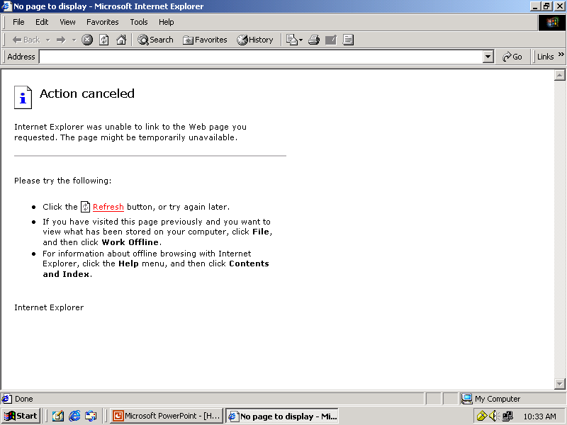
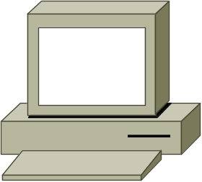
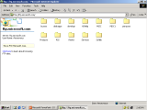
Example of FTP request
ftp://ftp.microsoft.com
Client
FTP Server

Slide 6
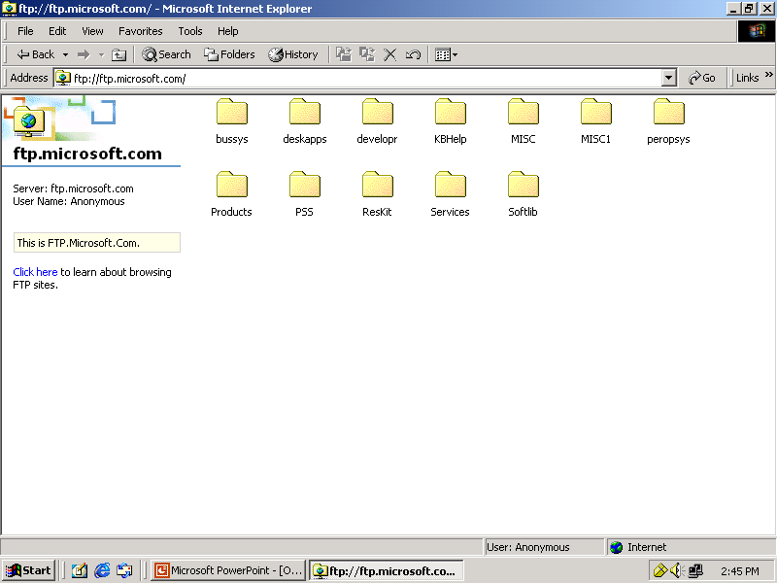

Example of FTP request
FTP Request
ftp://ftp.microsoft.com
FTP Request
Listen on
Port 21
Sending FTP Reply
Received FTP Reply
ftp://ftp.microsoft.com
Client
FTP Server

Slide 7
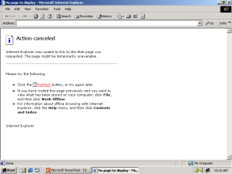

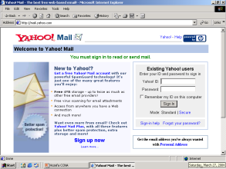
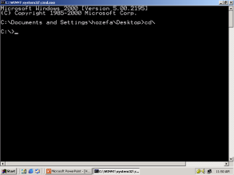
Examples of Networking Services
Service Port No.
HTTP 80
FTP 21
SMTP 25
TELNET 23
TFTP 69

Slide 8
How data flows from Application Layer
Application
Data
80
21
25
53
67
69
Presentation
Session
Transport
Network
Data Link
Physical

Slide 9
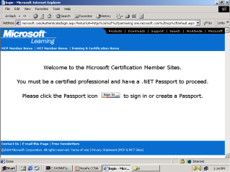
Presentation Layer
Application
Presentation Layer is responsible for converting data into standard format.
Examples : ASCII, EBCDIC, JPEG, MPEG, BMP, MIDI, WAV, MP3
Following tasks are perform at Presentation layer :
Encoding – Decoding
Encryption – Decryption
Compression – Decompression
Presentation
Presentation
Session
Transport
Network
Data Link
Physical

Slide 10
How data flows from Presentation Layer
Application
Data
Presentation
Data
Session
Transport
Network
Data Link
Physical

Slide 11
Session Layer
Application
Session Layer is responsible establishing, maintaining and terminating session.
Session ID also works at Session Layer.
Presentation
Session
Session
Transport
Network
Data Link
Physical

Slide 12
How data flows from Session Layer
Application
Data
Presentation
Data
Session
Data
Transport
Network
Data Link
Physical

Slide 13
Transport Layer
Application
Transport Layer is responsible for end-to-end connectivity.
It is also known as heart of OSI Layers.
Following tasks are performed at Transport Layer : -
  Identifying Service
  Multiplexing & De-multiplexing
  Segmentation
  Sequencing & Reassembling
  Flow Control
  Error Correction
Presentation
Session
Transport
Transport
Network
Data Link
Physical

Slide 14
Identifying Service
TCP
UDP
Transmission Control Protocol
Connection Oriented
Acknowledgement
Reliable
Slower
Port No. 6
e.g. HTTP, FTP, SMTP
User Datagram Protocol
Connection Less
No Acknowledgement
Unreliable
Faster
Port No. 17
e.g. DNS, DHCP, TFTP

Slide 15
Multiplexing & De-multiplexing
Application
Presentation
Session
80
21
25
53
67
69
Transport
TCP - 6
UDP - 17
Network
Data Link
Physical

Slide 16
Segmentation
Hello! How are you ?
Hello! How are you ?
Hello!
How
Are
You
?
A
B

Slide 17
Sequencing & Reassembling
you Hello! How ? are
Hello! How are you ?
Hello! How are you ?
You Hello! How ? Are
Hello!
How
?
Are
You
How
Are
You
?
Hello!
A
B

Slide 18
Sequencing & Reassembling
Hello! How are you ?
Hello! How are you ?
Hello! How are you ?
Hello! How are you ?
Hello!
1/5
Hello!
1/5
Are
3/5
Are
3/5
You
4/5
You
4/5
?
5/5
How
2/5
?
5/5
How
2/5
You
4/5
Hello!
1/5
How
2/5
?
5/5
Are
3/5
A
B

Slide 19
Error Correction
Hello! How are you ?
Segment Missing
Hello! How are you ?
Hello! How are you ?
Hello! How are you ?
Hello!
1/5
Hello!
1/5
Are
3/5
Are
3/5
You
4/5
You
4/5
?
5/5
Hello!
1/5
How
2/5
Are
3/5
You
4/5
?
5/5
How
2/5
?
5/5
You
4/5
Hello!
1/5
How
2/5
?
5/5
Are
3/5
A
B

Slide 20
Flow Control - Windowing
Sending 3-window
PC-A
can send 4 Segment at a time to
PC-B
Received 3-window
Ack. Received-4
Ack-Rec-3
Sending
5-window
Received 4-window
A
B

Slide 21
How data flows from Transport Layer
Application
Data
Presentation
Data
Session
Data
Transport
Segment
TH
Data
Network
Data Link
Physical

Slide 22
Network Layer
Application
Network Layer is responsible for providing best path to data to reach destination. Logical Addressing sits on this layer. Device working on Network Layer is Router.
It is divided into two parts
  Routed Protocols
  e.g. IP, IPX, Apple Talk.
  Routing Protocols
  e.g. RIP, IGRP, OSPF, EIGRP
Presentation
Session
Transport
Network
Network
Data Link
Physical

Slide 23
Routed Protocols
Segment
Segment
Hello! How are you ?
Hello! How are you ?
Source IP
192.168.1.1
Destination IP
192.168.1.2
Source IP
192.168.1.1
Destination IP
192.168.1.2
Segment
A
B
192.168.1.1
192.168.1.2

Slide 24
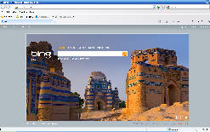

Routing Protocols
www.bing.com
A

Slide 25

How data flows from Network Layer
Application
Data
Presentation
Data
Session
Data
Transport
Segment
e.g. Router
Network
Packet
NH
Segment
Data Link
Physical

Slide 26
Datalink Layer
Application
Data link Layer is divided into two Sub Layers :
  LLC – Logical Link Control
  It talks about Wan protocols e.g. PPP, HDLC, Frame-relay
  MAC – Media Access Control
  It talks about Physical Address. It is 48 bit Addressing i.e. 12 digit Hexadecimal No. It is also responsible for Error Detection
  Device working on Data Link Layer is Switch, Bridge, NIC.
Presentation
Session
Transport
Network
Data Link
Data Link
Physical

Slide 27
Error Detection – CRC Check
PC-A
CRC No. 33333
PC-B
CRC No. 11114
Error Detected
For Error Correction
Contact Source Transport layer
Packet
Hello! How are you ?
Source MAC
00-20-18-C0-07-71
Destination MAC
00-20-18-C0-07-72
00000
32434
22222
89696
55434
99323
43434
99434
46323
11114
33333
00000
32434
22222
89696
55434
99323
43434
99434
46323
11114
Error Detected
Packet
A
B
192.168.1.1
00-20-18-C0-07-71
192.168.1.2
00-20-18-C0-07-72

Slide 28
Error Detection – CRC Check
Packet
Packet
Hello! How are you ?
Source MAC
00-20-18-C0-07-71
Destination MAC
00-20-18-C0-07-72
00000
32434
22222
89696
55434
99323
43434
99434
46323
11114
20202
00000
32434
22222
89696
55434
99323
43434
99434
46323
11114
20202
Source MAC
00-20-18-C0-07-71
Destination MAC
00-20-18-C0-07-72
Packet
A
B
192.168.1.1
00-20-18-C0-07-71
192.168.1.2
00-20-18-C0-07-72

Slide 29
How data flows from Data Link Layer
Application
Data
Presentation
Data
Session
Data
Transport
Segment
Network
Packet
e.g. Switch
Data Link
Frame
DH
Packet
Packet
DT
Physical

Slide 30
Physical Layer
Application
Physical Layer is responsible for electrical, mechanical or procedural checks. Data will be converted in Binary that is 0’s & 1’s. Data will be in the form of electrical pulses if it is Coaxial or Twisted Pair cable and in the form of Light if it is Fiber Optic Cable.
Devices working at Physical Layer are Hubs, Repeaters, Cables, Modems etc.
Presentation
Session
Transport
Network
Data Link
Physical
Physical

Slide 31
Physical Layer Example
Frame
Frame
Hello! How are you ?
1010101010101010
1010101010101010
Frame
A
1010101101010101010101010
B
0101011010101010101010101
1010101101010101010101010
0101011010101010101010101
0101011010101010101010101

Slide 32
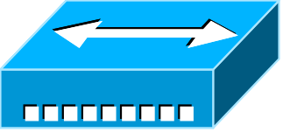
How data flows from Physical Layer
Application
Data
Presentation
Data
Session
Data
Transport
Segment
Network
Packet
Data Link
Frame
e.g. Hub
Physical
Bits

Slide 33
Data Encapsulation & De-capsulation
A
B
Application
Data
Data
Application
Presentation
Data
Data
Presentation
Session
Data
Data
Session
Transport
Transport
Segment
Segment
TH
TH
Data
TH
Data
Network
Packet
Packet
Network
NH
Segment
NH
Segment
NH
Data Link
Packet
Data Link
Frame
DH
Frame
DH
Packet
Packet
Packet
DT
DT
DH
DT
Physical
Bits
Bits
Physical

Slide 34
Comparing OSI with TCP/IP Layers
OSI Layers
TCP/IP Layers
Application
Application
Presentation
Session
Transport
Transport
Network
Internet
Data Link
Network
Access
Physical

Slide 35
THE END

